Slide 1
Synchronous Sequential Logic
Chapter 5

Slide 2
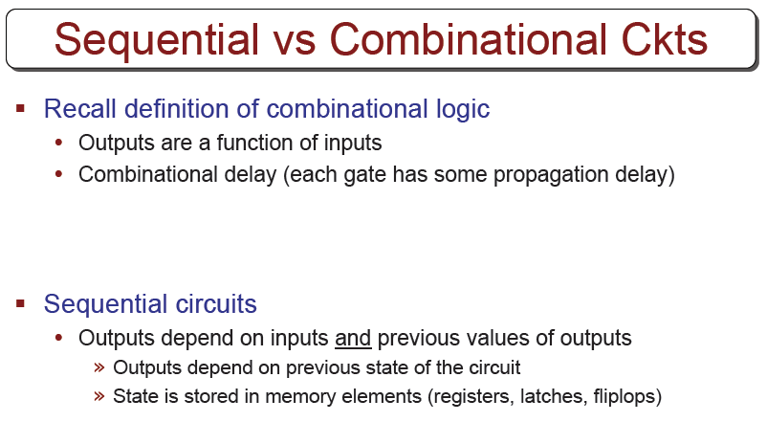

Slide 3
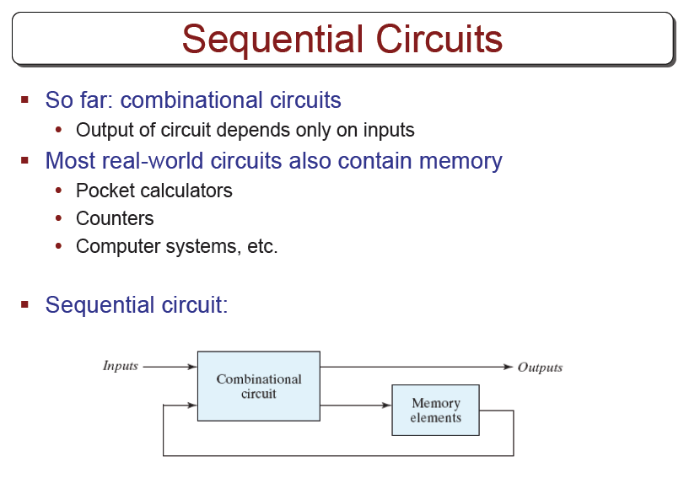

Slide 4
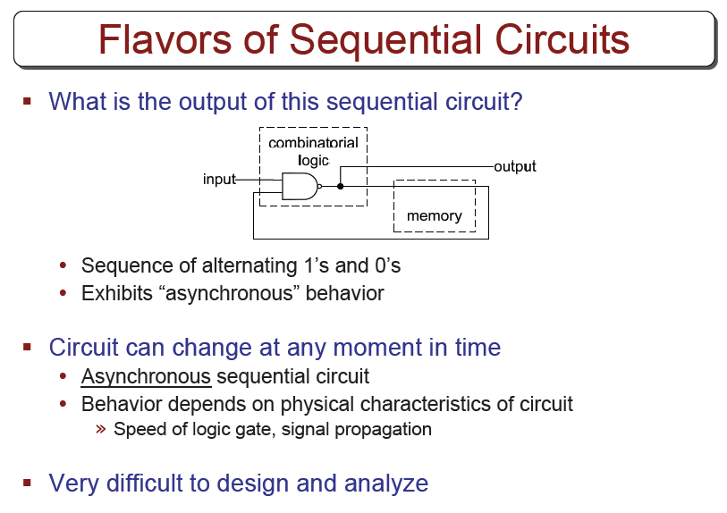

Slide 5
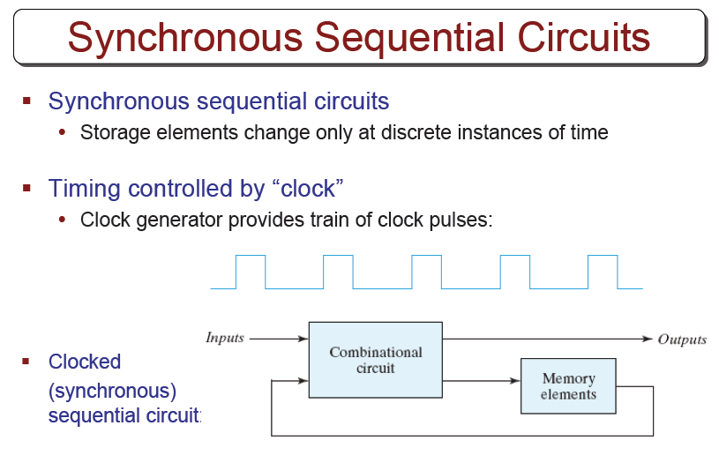
Notes:
A synchronous sequential circuit employs signals that affect the storage elements at only discrete instants of time. Synchronization is achieved by a timing device called a clock generator, which provides a clock signal having the form of a periodic sequence of clock pulses.
In practice, the clock pulses determine when computational activity will occur within the circuit, and other signals (external) determine what changes will take place affecting the storage elements and the outputs.
The storage elements (memory) used in clocked sequential circuits are called flip-flops. A flip-flop is a binary storage device capable of storing one-bit information. In a stable state, the output of a flip-flop is either 0 or 1. A sequential circuit may use many flip-flops to store as many bits as necessary.

Slide 6
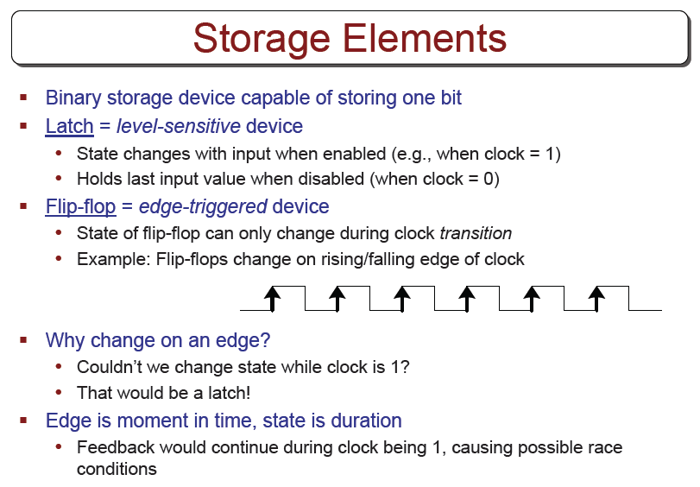

Slide 7
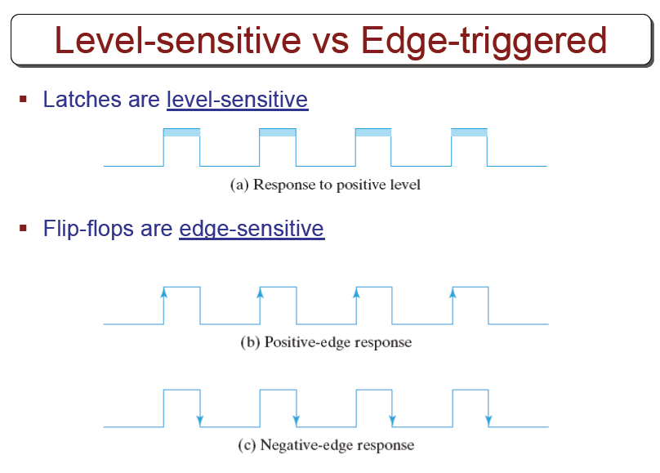

Slide 8
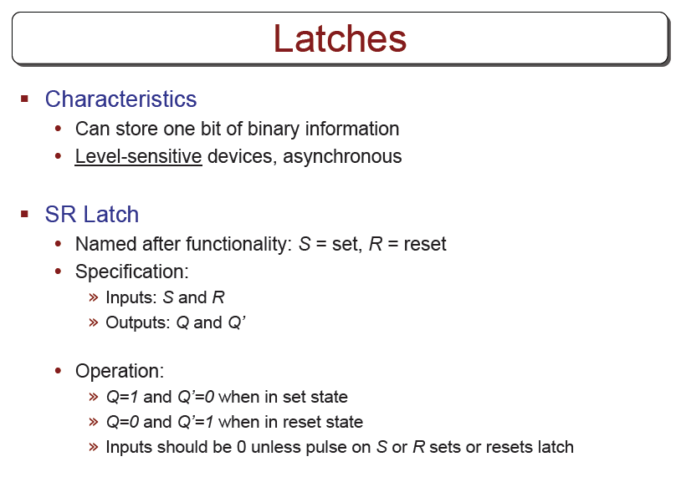

Slide 9
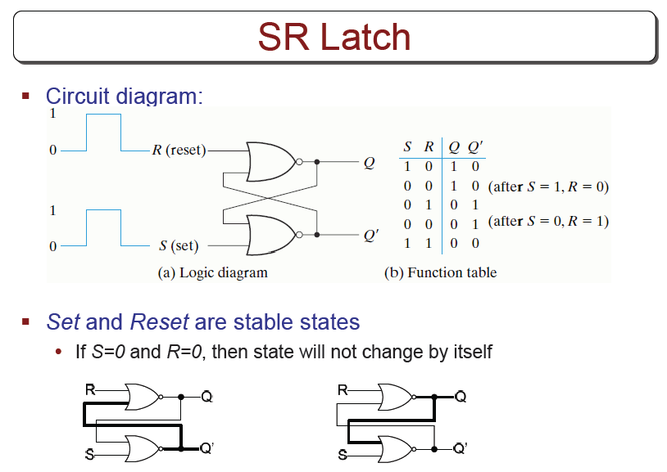

Slide 10
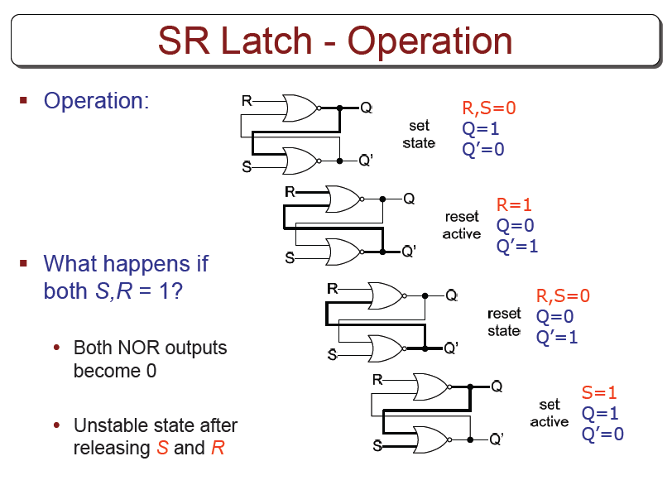

Slide 11
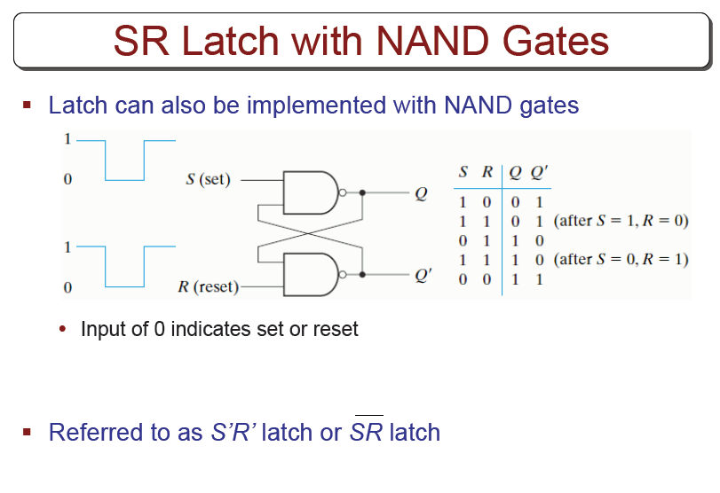

Slide 12
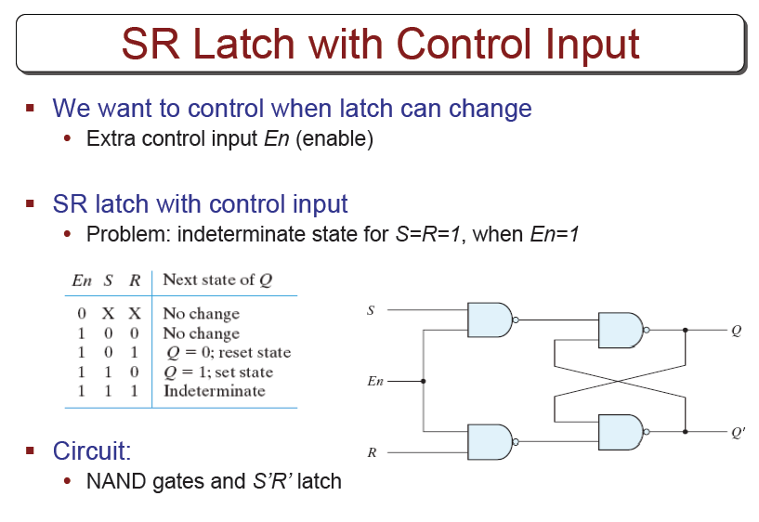

Slide 13
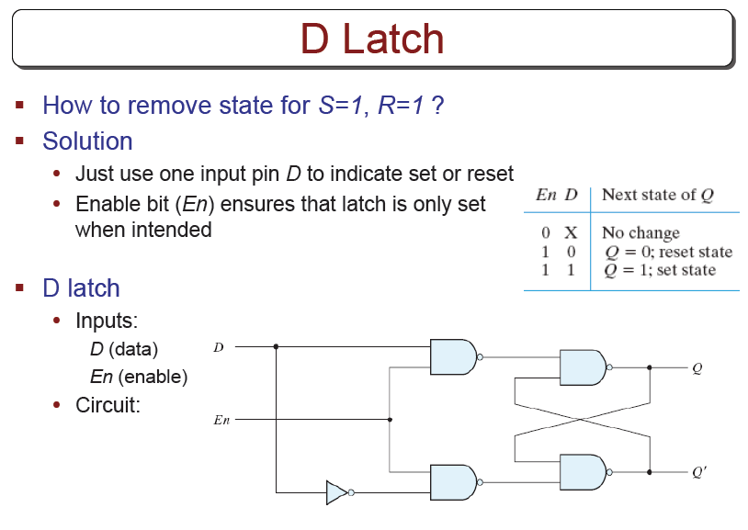

Slide 14
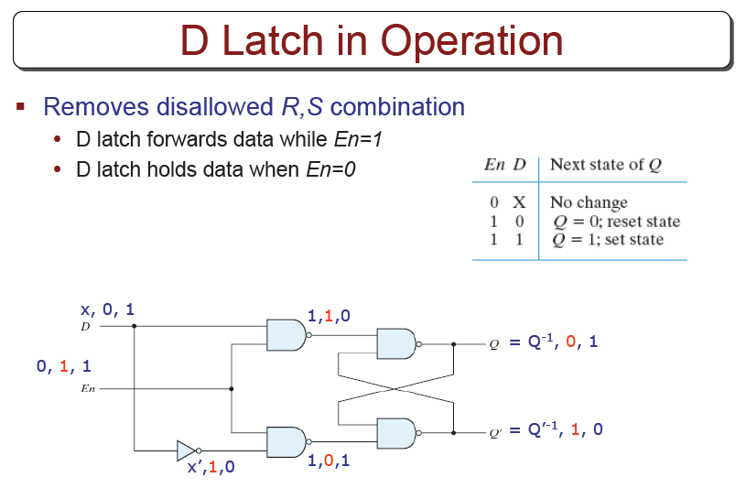

Slide 15
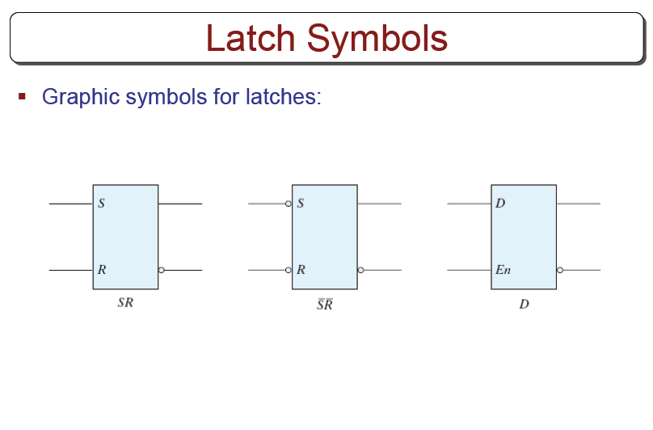

Slide 16
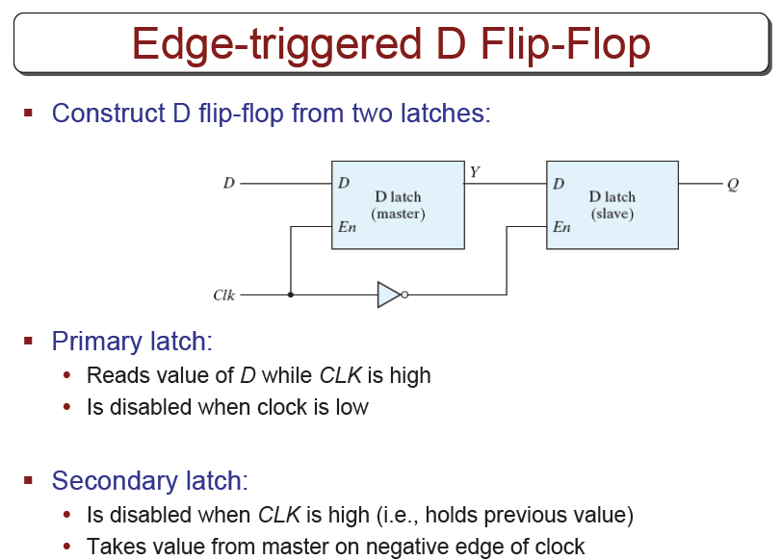

Slide 17
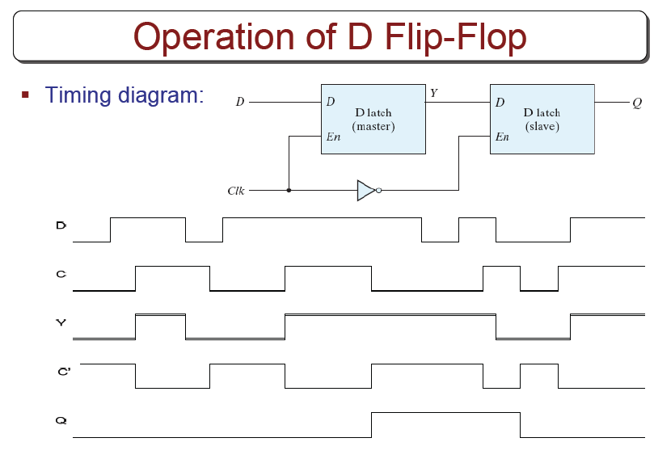

Slide 18
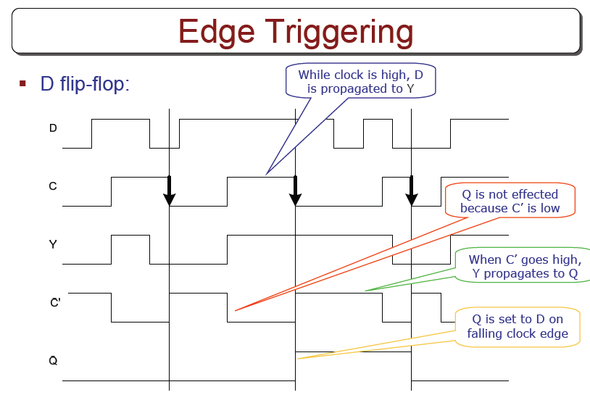

Slide 19
Other Flip Flops
D flip flops requires smallest number of gates.
Thus, they are commonly used
Other flip flops are
  JK flip flops
  T flip flops

Slide 20
Three operations of flip flops
Three operations that can be performed with flip flops are
  Set it to 1
  Reset it to 0
  Complement its output
D flip flop can only set and reset
JK has two inputs and can perform all three operations

Slide 21
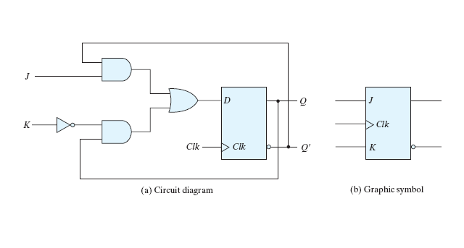
JK flip flop
J input sets to 1
K input resets to 0
When both inputs are enabled, output is complemented.

Slide 22
JK flip flop
The function of the D input:
D=JQ’+K’Q
  When J=1 AND K=0, D=Q’+Q=1
  When J=0 AND K=1, D=0
  When J=1 AND K=1, D=Q’ (complemented)
  When J=0 AND K=0, D=Q (unchanged)

Slide 23
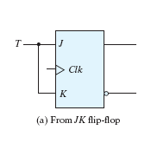
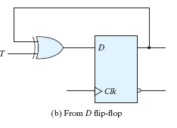

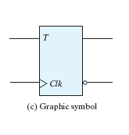
T (toggle) flip flop
It is a complementing ff.
J and K are tied together (Fig a)
  When T=0 (J=K=0), no change
  When T=1 (J=K=1), complement
Can be constructed from D ff (Fig b)
  When T=0, D=Q (no change)
  When T=1, D=Q’ (complement)

Slide 24
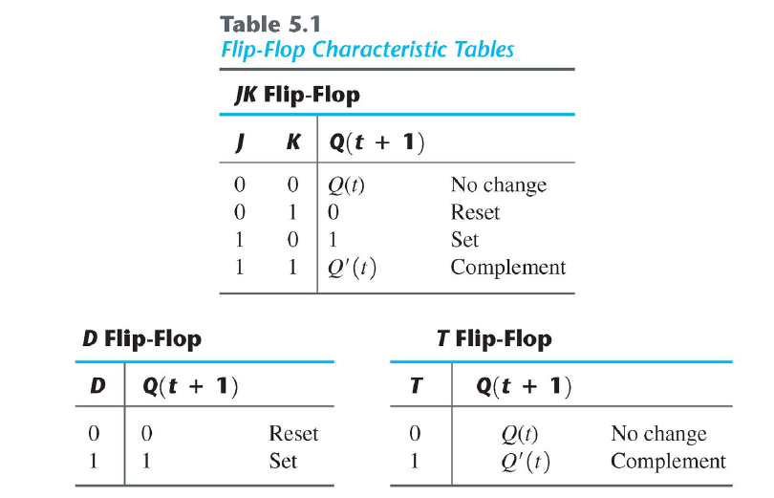
Characteristic Tables
Q(t) refers to the presents state.
Q(t+1) refers to the next state.

Slide 25

Characteristic Equations
D flip flop
  Q(t+1)=D
JK flip flop
  Q(t+1)=JQ’+K’Q
T flip flop

Slide 26
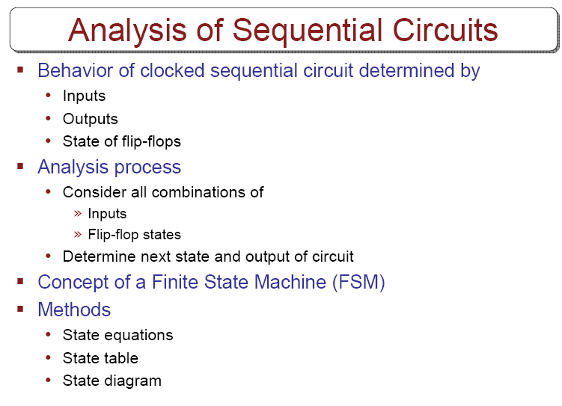

Slide 27
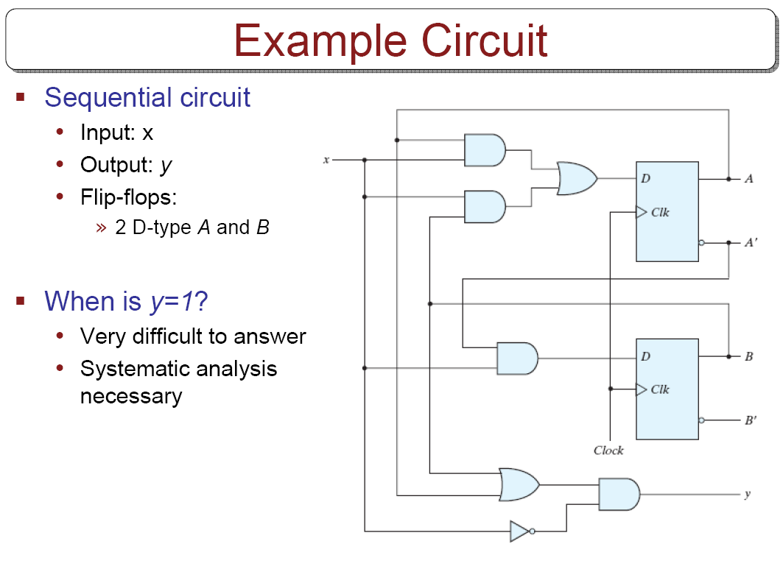

Slide 28
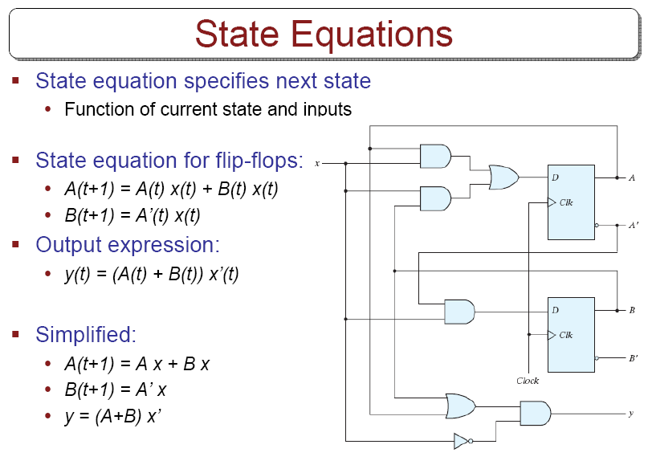

Slide 29
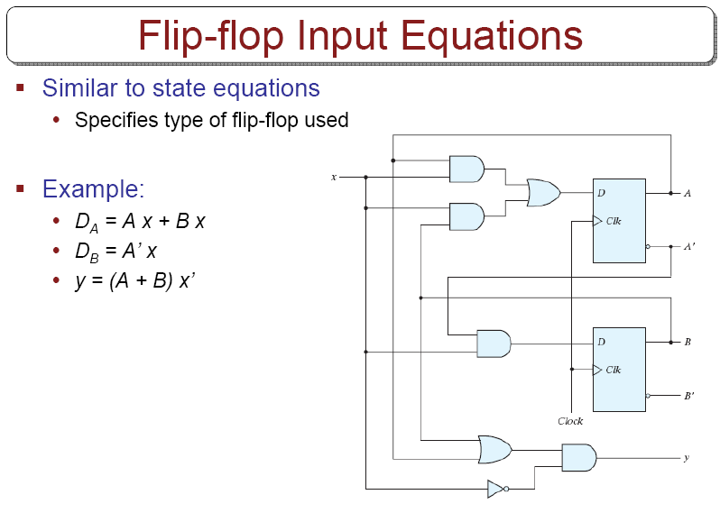

Slide 30
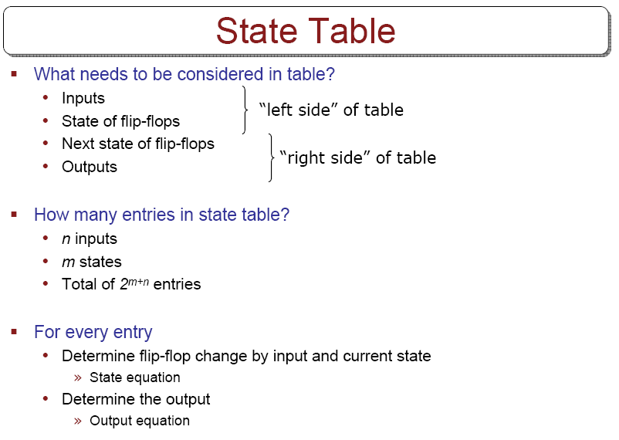

Slide 31
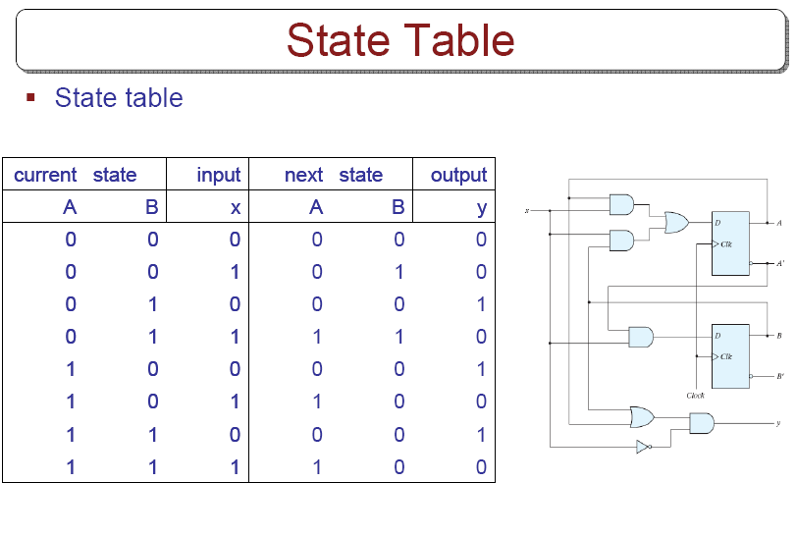

Slide 32
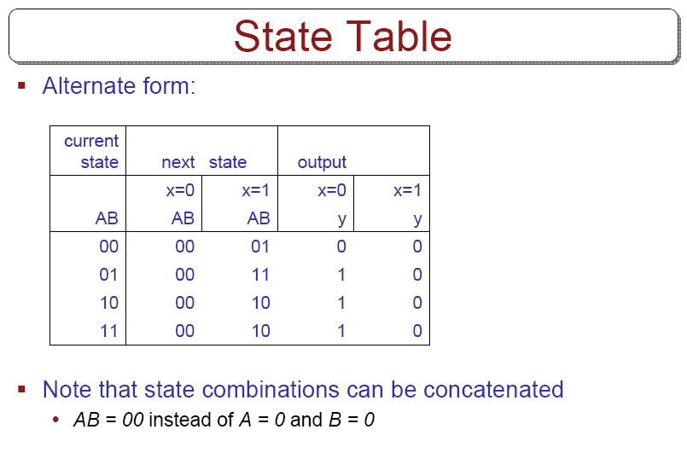

Slide 33
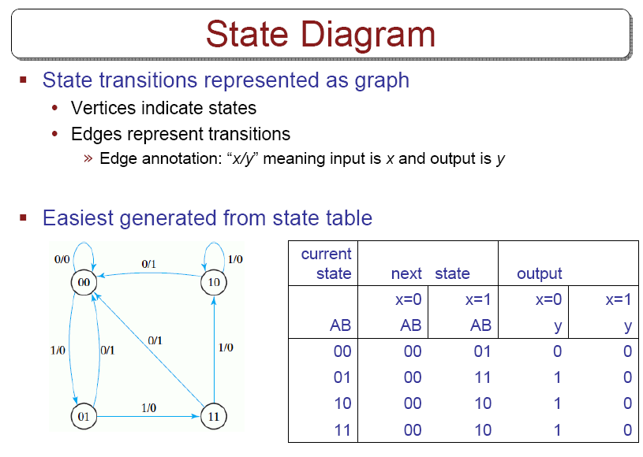

Slide 34
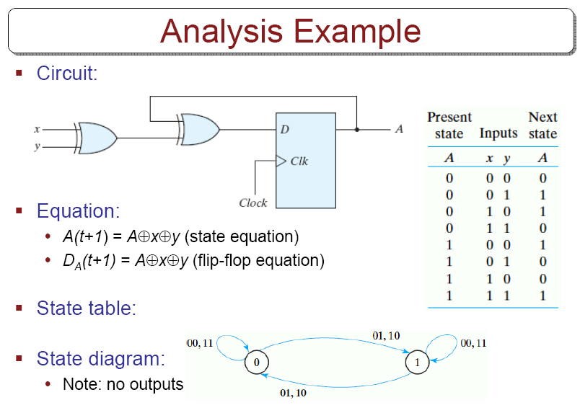

Slide 35
Analysis with JK flip-flops
For D flip-flops, state equation is the same as the input equation.
For JK and T flip-flops, we refer to characteristic equations.
The next state values for JK and T ffs can be derived as follows:
  1. Determine the ff input equation in terms of present state and input variables.
  2. List the binary values of each input equation.
  3. Use ff characteristic table to determine the next-state values in the state table.

Slide 36
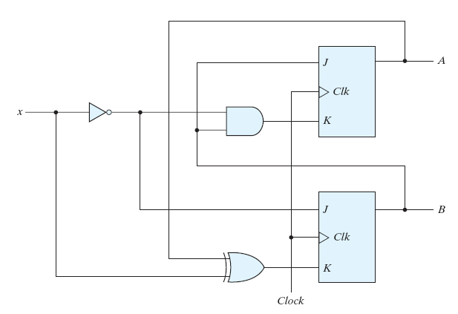
Example
Circuit has no outputs.
  No need for
  output column
FF input eq.s
J_{A}=B , K_{A}=Bx’
J_{B}=x’ , K_{B}=A’x+Ax’

Slide 37
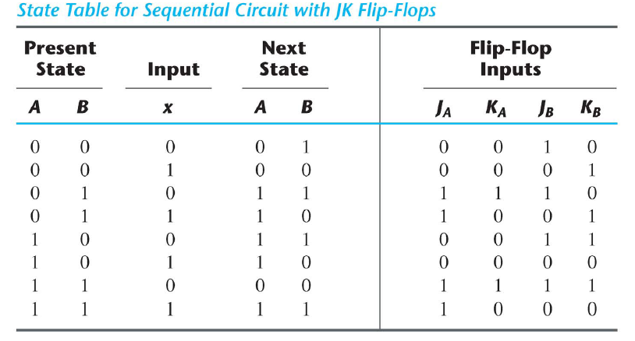
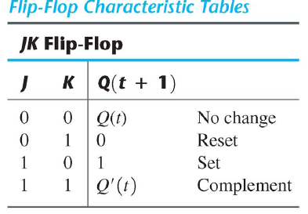
State Table of Example

Slide 38
2nd method (using state equations)
The next state values can also be obtained by evaluating the state equations:
  1. Determine the ff input equations.
  2. Substitute the input equations into ff characteristic equations to obtain the state equations.
  3. Use the corresponding state equations to determine the next state values.

Slide 39
Using state equations
1. Determine ff equations
J_{A}=B , K_{A}=Bx’
J_{B}=x’ , K_{B}=A’x+Ax’
2. Substitude them into ff characteristic eq.s:
  A(t+1)=JA’+K’A=BA’+(Bx’)’A=A’B+AB’+Ax
  B(t+1)=JB’+K’B=
3. Using state equations, obtain next state values.

Slide 40
From state equations to state table
A(t+1)=A’B+AB’+Ax
B(t+1)=B’x’+ABx+A’Bx’

Slide 41
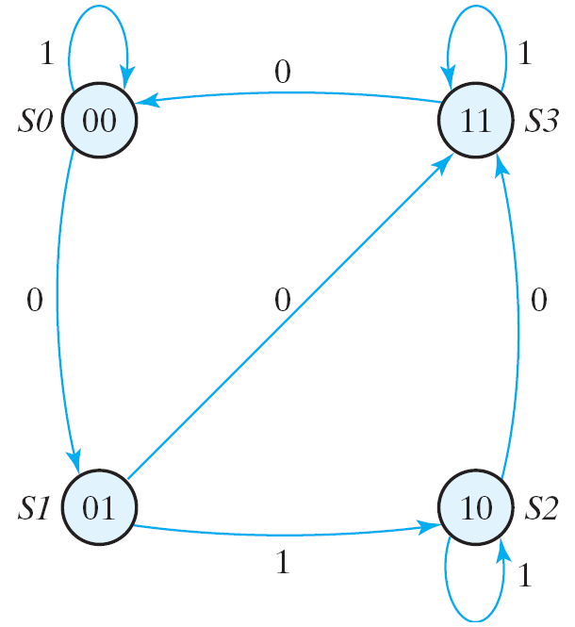
State diagram
Obtain state diagram

Slide 42

Analysis with T Flip-Flops
Same procedure as explained for JK ffs
  Either use
    Characteristic table or
    Characteristic equations
Characteristic equations for T ffs

Slide 43
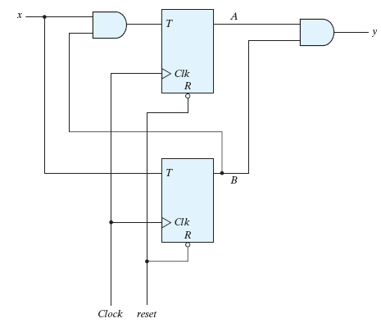
Example
Input eq.s, output eq.
T_{A}=Bx
T_{B}=x
y=AB
Substitute them into characteristic eq.s
A(t+1)=(Bx)’A+(Bx)A’
=AB’+Ax’+A’Bx
B(t+1)=x’B+xB’=x(XOR)B

Slide 44
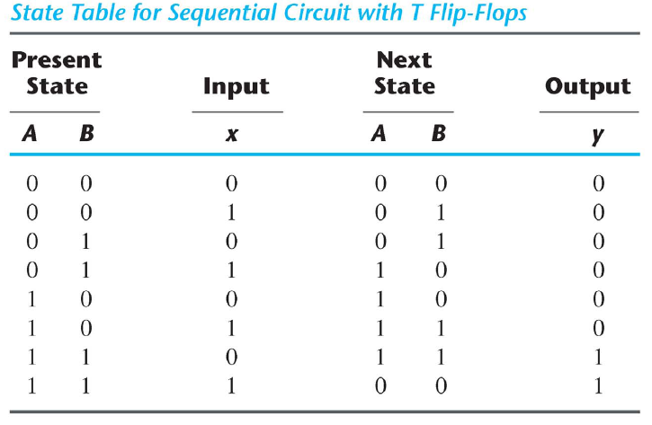
Example
A(t+1)=AB’+Ax’+A’Bx
B(t+1)=x’B+xB’=x(XOR)B
y=AB
Obtain state table

Slide 45
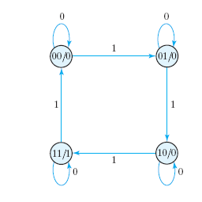
State diagram
Obtain state diagram

Slide 46
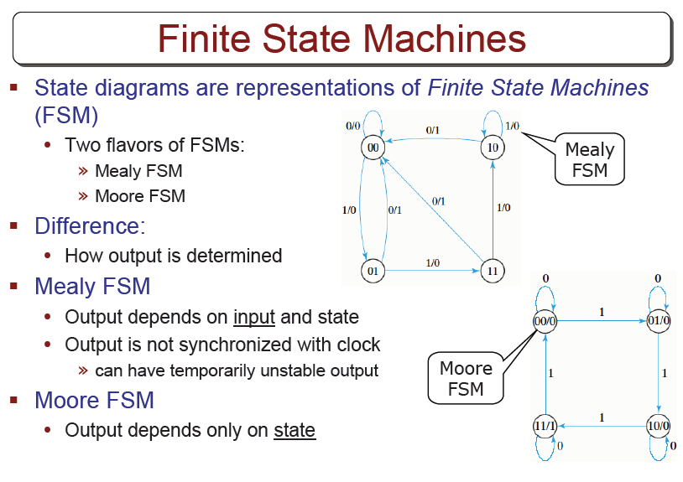

Slide 47
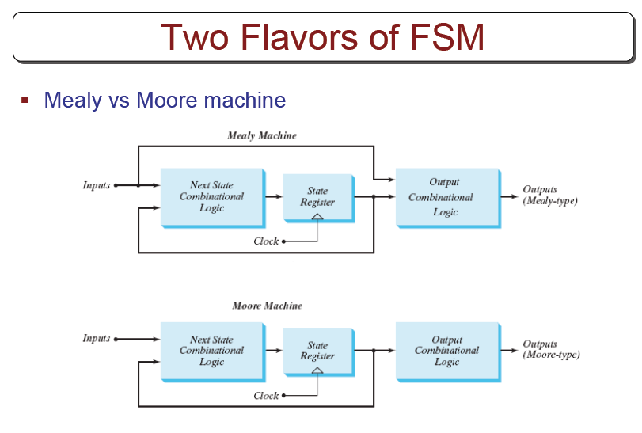

Slide 48
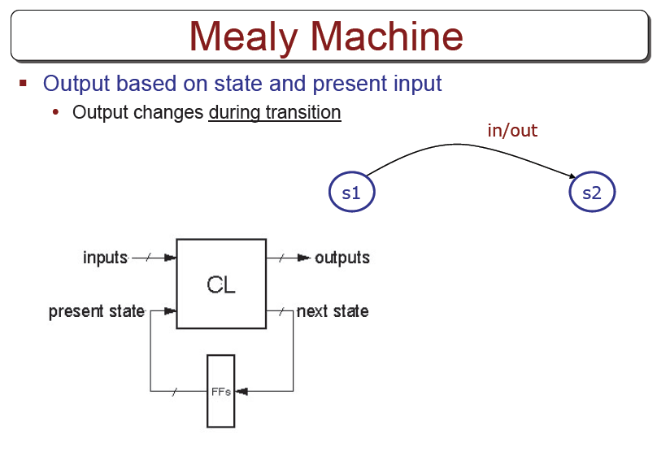

Slide 49
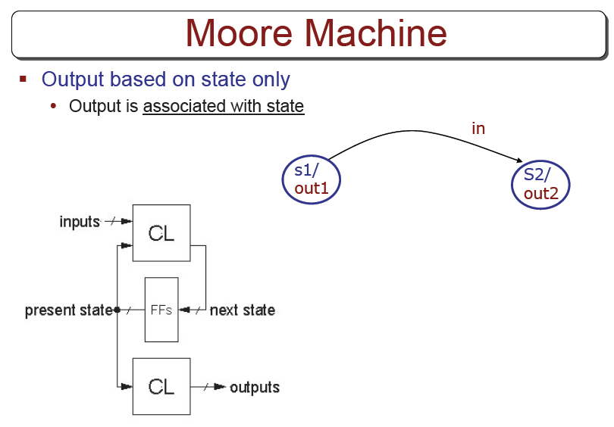

Slide 50
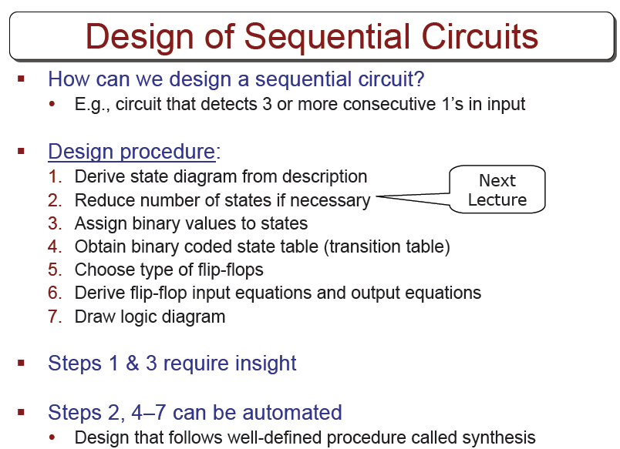

Slide 51
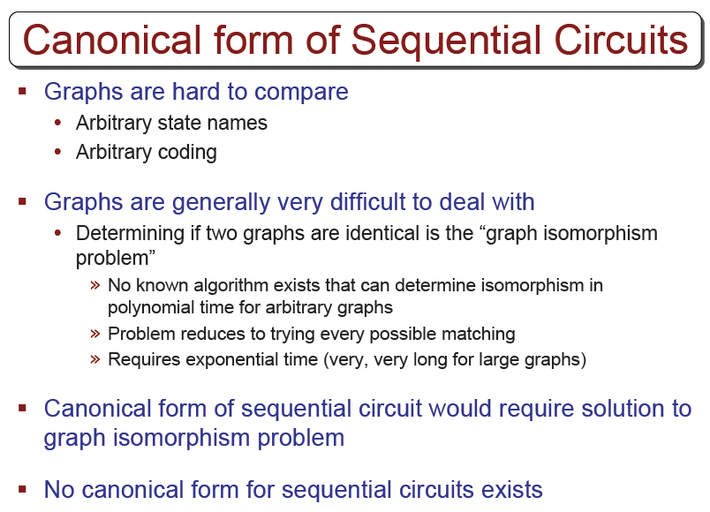

Slide 52
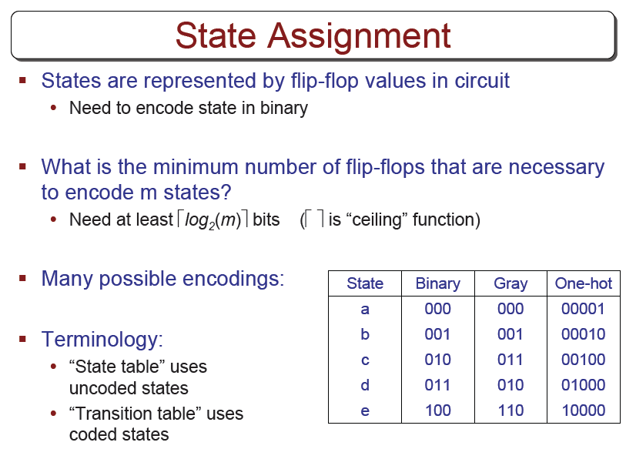

Slide 53
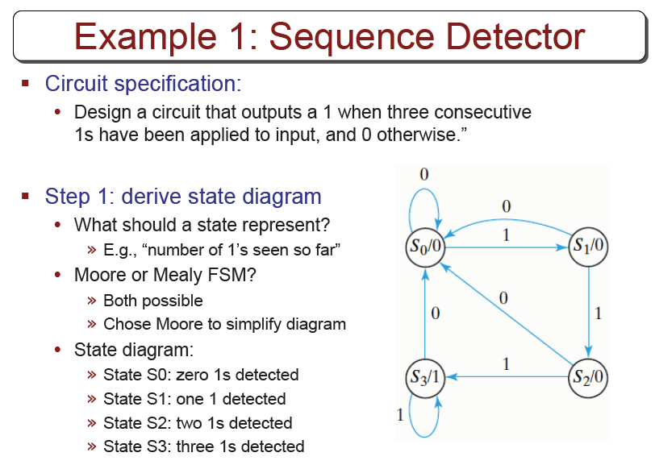

Slide 54
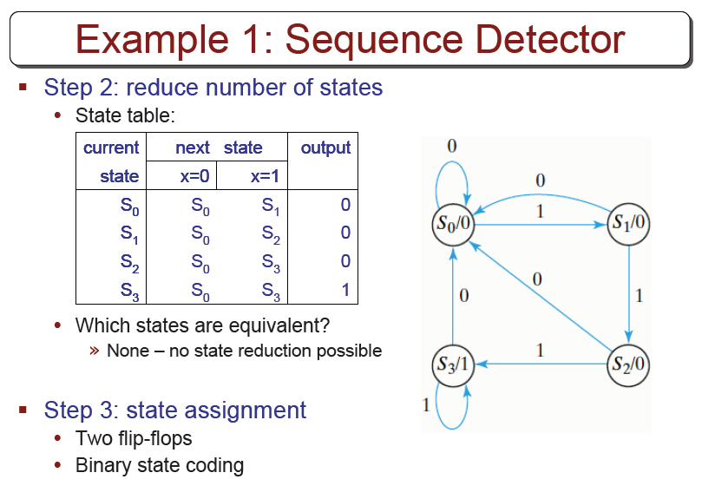

Slide 55
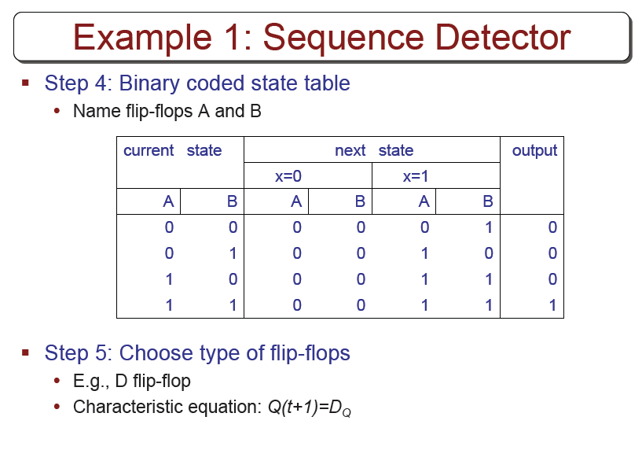

Slide 56
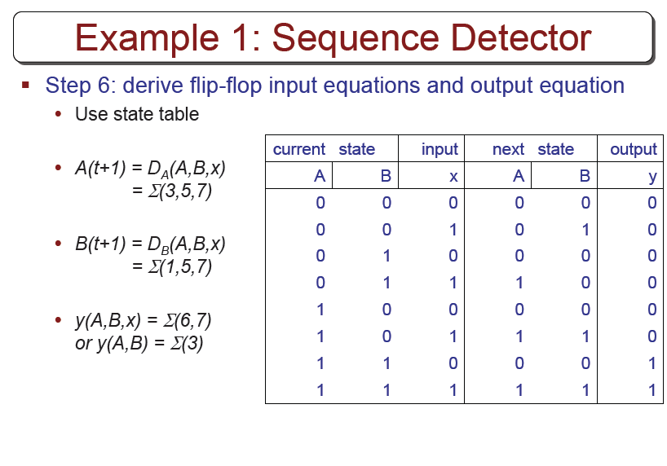

Slide 57
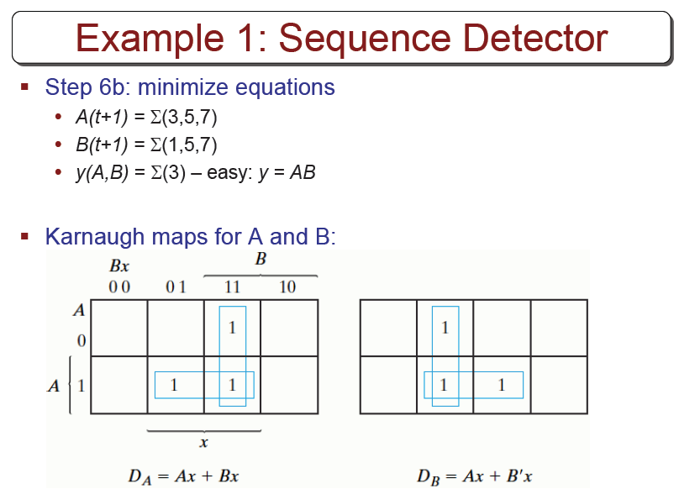

Slide 58


Slide 59


Slide 60
Excitation Tables
When we use D ff, state equations is found directly from the next state.
  We cannot do this for JK and T ffs
  We need function table for these ffs
The table that lists the required ff inputs for the transitions from present state to next state is called excitation table.
  Values for the present state and next state is given.
  What values should be applied to flip-flop inputs?

Slide 61


Excitation Table for JK and T

Slide 62

Synthesis Using JK Flip-Flops
Apply the same procedure as we did for D flip-flops
  Except that the input equations should be evaluated by using excitation tables.

Slide 63

Example

Slide 64

Draw the circuit

Slide 65

Synthesis Using T Flip-Flops
Design a 3-bit binary counter
  At each clock transition, the value of the state will be increased by one
    000, 001, 010, 011….111,000,…..
  Draw the state diagram

Slide 66

Binary counter
Create the state table

Slide 67

FF Input Functions

Slide 68

Counter circuit

Slide 69
FSM State Reduction

Slide 70


Slide 71


Slide 72


Slide 73


Slide 74


Slide 75


Slide 76


Slide 77


Slide 78


Slide 79
Questions - 1
(Q.5.5) A sequential circuit with two D flip-flops A and B, two inputs x and y, and one output z is specified by the following next state and output equations
      A(t+1)=x’y+xB
      B(t+1)=x’A+xB
      Z=A
    Draw the logic diagram of the circuit.
    List the state table for the sequential circuit.
    Draw the corresponding state diagram.

Slide 80

Questions - 2
(Q.5.6) Derive the state table and the state diagram of the sequential circuit shown below. Explain the function that the circuit performs.

Slide 81
Questions - 3
(Q.5.12) Design a sequential circuit with two D flip-flops A and B and one input x_in.
  When x_in=0, the state of the circuit remains the same. When x_in=1, the circuit goes through the state transitions from 00 to 01, to 11, to 10, back to 00, and repeats.
  When x_in=0, the state of the circuit remains the same. When x_in=1, the circuit goes through the state transitions from 00 to 11, to 01, to 10, back to 00, and repeats.

Slide 82
Questions - 4
(Q.5.14) Design a sequential circuit with two JK flip-flops A and B and two inputs E and F.
  If E=0, the circuit remains in the same state regardless of the value of F.
  When E=1 and F=1, the circuit goes through the state transitions from 00 to 01, to 10, to 11, back to 00, and repeats.
  When E=1 and F=0, the circuit goes through the state transitions from 00 to 11, to 10, to 01, back to 00, and repeats.
        (Up and down counter with enable. Count up when F=1, count down when F=0.)

Slide 83

Questions - 5
(Q.5.15) A sequential circuit has three flip-flops A,B,and C; one input x_in; and one output y_out. The state diagram is shown at right. The circuit is to be designed by treating the unused states as don’t-care conditions. Analyze the circuit obtained from the design to determine the effect of the unused states.
  Use D flip-lops in the design.
  Use JK flip-flops in the design.

